Slide 1
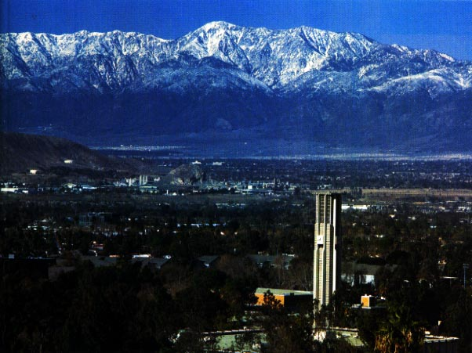
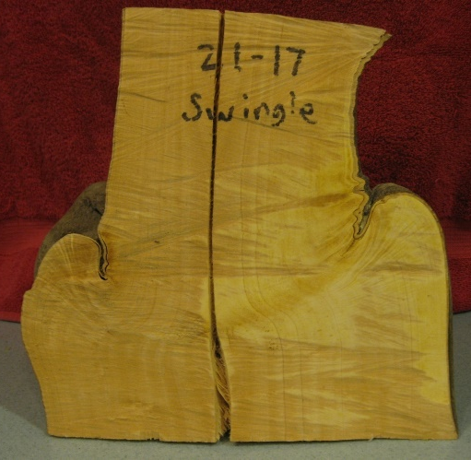
Citrus Rootstocks-Soils ,Densities, and Compatibilities – October 2014 Mikeal Roose, Claire Federici, Ricki Kupper http://plantbiology.ucr.edu/faculty/roose.html

Slide 2
Citrus Rootstocks in California
Major rootstocks | Minor rootstocks | New Rootstocks
Carrizo/Troyer | C32 citrange | Bitters (C22)
C35 citrange | Benton citrange | Carpenter (C54)
Rich 16-6 trifoliate | African shaddock x Rub. trif. | Furr (C57)
Rubidoux trifoliate | Sun Chu Sha | X639
Pomeroy trifoliate | Sweet orange | Trifeola
Swingle | Grapefruit (343 etc.) | US 812
Sour orange | Taiwanica | US 852
Rough lemon (Schaub etc.) | Rangpur | Fourner-Alcide 5?
Volkameriana
Cleopatra
Macrophylla

Slide 3
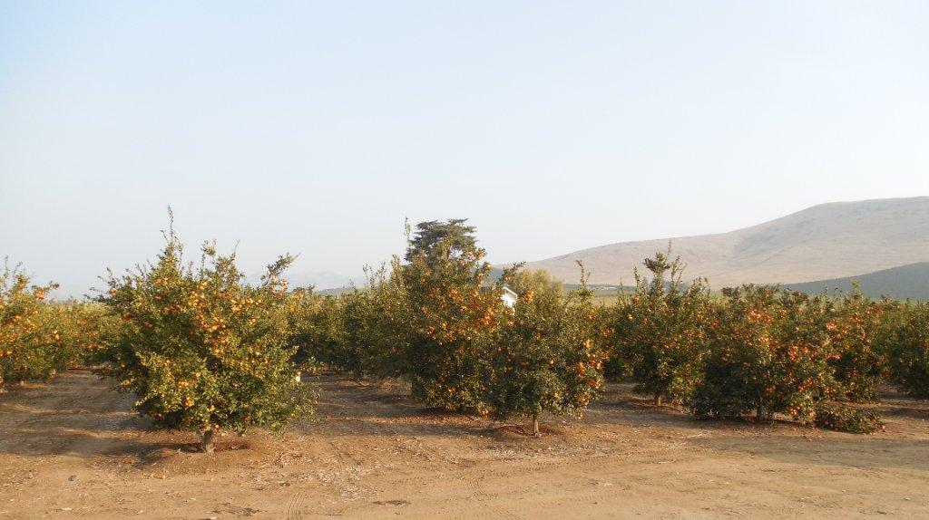
Porterville Tango Rootstock Trial Planted 2008 – 23 rootstocks
Location: 5 mi SE of Porterville
Soil type: clay-organic (Porterville Adobe)
pH: 7.7-8.05
Limestone: < 0.10
Physical problems: CEC high, CEC (Ca) high, high clay, high pH
Ions at low concentration: K(sol), Mg, Fe, B

Slide 4
Porterville 2008 Tango Rootstock Trial (Part 1) Ranked by canopy volume in 2013
Stock | 2012 Fruit Count | 2013 Yield (lb/tree) | 2013 Fruit Weight (g) | 2014 Yield (lb/tree) | 2013 Canopy Volume (m³) | 2013 Tree Health Rating
C35 | 89.4 | 181.0 | 74.4 | 172.0 | 9.28 | 3.95
Carpenter | 61.4 | 138.9 | 67.0 | 151.6 | 9.01 | 4.07
Sunki x FD trif | 103.3 | 147.2 | 76.6 | 129.2 | 7.73 | 4.00
Volk | 76.9 | 93.8 | 73.0 | 38.5 | 7.30 | 3.73
Brazil Sour | 60.2 | 92.8 | 69.4 | 56.9 | 7.20 | 4.14
Yuma Ponderosa | 58.5 | 118.0 | 73.4 | 71.3 | 7.09 | 4.23
Bitters | 141.0 | 161.2 | 72.8 | 149.9 | 7.08 | 3.56
Schaub RL | 69.1 | 56.8 | 65.4 | 20.5 | 6.97 | 3.36
ASRT | 64.1 | 90.6 | 67.0 | 107.5 | 6.86 | 3.28
Swingle | 30.5 | 112.1 | 72.4 | 118.2 | 6.85 | 3.18

Slide 5
Porterville 2008 Tango Rootstock Trial (Part 2)
Stock | 2012 Fruit Count | 2013 Yield (lb/tree) | 2013 Fruit Weight (g) | 2014 Yield (lb/tree) | 2013 Canopy Volume (m³) | 2013 Tree Health Rating
Rangpur x Sw. trif | 50.9 | 89.8 | 69.2 | 87.8 | 6.70 | 3.17
Tosu | 29.9 | 57.3 | 64.0 | 64.0 | 6.58 | 3.80
Carrizo | 58.3 | 93.7 | 73.0 | 73.0 | 6.55 | 3.64
Cleopatra | 59.5 | 60.3 | 65.6 | 65.6 | 6.53 | 3.59
Rangpur x Marks trif | 49.3 | 100.4 | 70.2 | 70.2 | 6.53 | 3.64
Rangpur x Shekwasha | 43.5 | 78.3 | 65.8 | 65.8 | 5.85 | 2.91
Sun Chu Sha | 23.8 | 39.1 | 66.0 | 66.0 | 5.71 | 2.83
Pomeroy trif. | 39.8 | 44.0 | nd | nd | 5.57 | 2.00
Macrophylla | 70.3 | 88.2 | 76.0 | 76.0 | 5.52 | 3.45
Koethen Sweet | 7.4 | 62.5 | 63.3 | 63.3 | 4.97 | 3.00
S. Barb. Red Lime | 68.7 | 75.8 | 76.0 | 76.0 | 4.88 | 3.32
Obovoidea | 18.1 | 32.3 | 66.6 | 66.6 | 4.74 | 2.68
Rich 16-6 trif | 21.6 | 27.5 | 65.4 | 65.4 | 3.70 | 1.75
LSD (0.05) | 35.1 | 29.3 | 4.9 | 32.7 | 1.38 | 0.60

Slide 6
Porterville 2008 Tango Rootstock Trial (Part 3)
Stock | 2013 Bud Union Rating | 2013 Sucker Count | 2013 Iron Chlorosis Rating
C35 | 2.86 | 0.00 | 0.55
Carpenter | 4.00 | 0.00 | 0.79
Sunki x FD trif | 3.23 | 0.27 | 0.23
Volk | 4.59 | 0.18 | 0.59
Brazil Sour | 4.32 | 0.18 | 0.05
Yuma Ponderosa | 3.59 | 0.91 | 0.00
Bitters | 4.00 | 0.00 | 0.00
Schaub rough lemon | 4.32 | 3.18 | 0.41
ASRT | 3.22 | 0.22 | 1.06
Swingle citrumelo | 1.73 | 0.73 | 2.14
Iron chlorosis rated 0 (none) to 5 (dead)

Slide 7
Porterville 2008 Tango Rootstock Trial (Part 4)
Stock | 2013 Bud Union Rating | 2013 Sucker Count | 2013 Iron Chlorosis Rating
Rangpur x Swingle trif | 3.56 | 6.33 | 1.17
Tosu | 3.65 | 0.50 | 0.20
Carrizo | 3.14 | 0.18 | 0.09
Cleopatra | 5.82 | 2.00 | 0.14
Rangpur x Marks trif | 2.77 | 0.00 | 0.23
Rangpur x Shekwasha | 3.36 | 4.00 | 1.59
Sun Chu Sha | 6.11 | 2.89 | 1.39
Pomeroy trif. | 2.00 | 0.00 | 3.50
Macrophylla | 5.82 | 0.00 | 0.00
Koethen Sweet | 5.00 | 0.20 | 0.25
Santa Barbara Red Lime | 4.64 | 1.36 | 0.36
Obovoidea | 4.18 | 0.64 | 0.45
Rich 16-6 trif | 2.00 | 0.30 | 2.95
LSD (0.05) | 0.68 | 1.91 | 0.74

Slide 8
Porterville 2008 Tango Rootstock Trial Fruit Quality Study in Feb. 2012
Rootstock | Fruit Wt (g) | Puff Rating | Juice (%) | Brix | Acid | Solids :Acid Ratio | Calif. Standard
Carrizo | 69.3 | 0.22 | 37.7 | 12.2 | 1.17 | 10.4 | 124
Bitters (C22) | 68.5 | 0.32 | 40.3 | 12.2 | 1.12 | 10.9 | 126
C35 | 63.7 | 0.34 | 37.9 | 11.6 | 1.09 | 10.7 | 119
Brazil Sour | 63.5 | 0.32 | 37.0 | 12.2 | 1.10 | 11.4 | 129
Macrophylla | 63.0 | 0.76 | 32.3 | 9.0 | 0.94 | 9.8 | 86
Volk | 59.3 | 0.94 | 33.6 | 11.5 | 1.07 | 10.9 | 120
LSD (0.05) | ns | 0.44 | 4.3 | 0.81 | 0.17 | ns | 15
California Standard values computed using k=3.0 as suggested for mandarins rather than k=4 as used for oranges

Slide 9
Porterville 2008 Tango Rootstock Trial Fruit Quality Study in Feb. 2014 (selected stocks)
Rootstock | Fruit Wt (g) | Juice (%) | Brix | Acid | Solids :Acid Ratio | Calif. Standard
Carrizo | 74.7 | 41.7 | 13.8 | 1.06 | 13.0 | 157
Bitters (C22) | 83.7 | 39.7 | 13.7 | 1.02 | 13.5 | 159
C35 | 87.3 | 37.6 | 13.2 | 1.03 | 12.8 | 149
Brazil Sour | 72.2 | 41.1 | 13.5 | 1.20 | 11.3 | 143
Macrophylla | 71.7 | 38.2 | 11.0 | 0.96 | 11.5 | 118
Volk | 75.2 | 38.4 | 11.7 | 0.95 | 12.4 | 131
ASRT | 74.1 | 41.3 | 14.3 | 1.16 | 12.4 | 159
Rich 16-6 | 73.6 | 37.5 | 14.1 | 1.28 | 11.0 | 148
Swingle | 73.4 | 40.1 | 12.9 | 1.13 | 11.4 | 138
Cleopatra | 62.7 | 40.8 | 13.7 | 1.17 | 11.8 | 149
Schaub RL | 62.4 | 41.0 | 12.0 | 0.97 | 12.4 | 134
LSD(0.05) | 11.3 | 3.8 | 0.70 | 0.13 | 1.5 | 13

Slide 10
2008 Tango Trial at Porterville vs 2009 Tango Trial at Arvin Rootstock Means Between Sites (low correlation)
SB Red Lime
Schaub RL
Macrophylla
Volk
Sunki x FD
Brazil sour
C35
Obovoidea
Carrizo
Rich 16-6
Swingle
Pomeroy
Cleo
Koethen sweet

Slide 11
Soil Comparisons – Porterville vs Arvin
Characteristic | Arvin | Porterville
Location | 6 mi SE of Bakersfield | 5 mi SE of Porterville
soil type | sandy-loam | clay-organic
pH | 7.1-7.35 | 7.7-8.05
Limestone | <0.10% | <0.10%
Physical problems | none | CEC high, CEC (Ca) high, high clay, high pH
Ions at low conc. | K₂0 (sol), Mg(sol), B | K(sol), Mg, Fe, B

Slide 12
UCR Precocity Trial
Objective: identify rootstocks that are more productive at young ages for use in high density plantings in HLB areas
Washington navel on 23 stocks planted in Sept. 2011
Spacing: 21 ft x 9.5 ft
Trial trees on berms with weedblock, soil amended with compost and gypsum, irrigation managed using Deere capacitance monitors, 2x/year Ridomil treatment
Tree growth appears very good (for UCR)
First yields collected in Feb. 2014

Slide 13
UCR Precocity Rootstock Trial – W. navel Ranked by canopy volume in 2013 (selected rootstocks)
Stock | 2013 Canopy Volume (m3) | 2014 Yield (lb/tree) | 2014 Fruit Weight (g) | 2013 Tree Health Rating
Yuma Ponderosa | 2.04 | 22.1 | 0.62 | 4.56
Volk | 2.00 | 22.9 | 0.67 | 4.31
Schaub rough lemon | 1.88 | 11.8 | 0.61 | 4.28
Afr Shad x Rub trif. | 1.73 | 8.7 | 0.58 | 4.25
Rangpur x Marks trif. | 1.62 | 7.0 | 0.61 | 4.11
Macrophylla | 1.53 | 18.3 | 0.63 | 4.28
Carrizo | 1.46 | 8.0 | 0.50 | 4.00
C35 | 1.46 | 10.2 | 0.54 | 4.35
Cleopatra | 1.44 | 10.0 | 0.48 | 4.11
Bitters | 1.25 | 13.8 | 0.58 | 4.05
Rich 16-6 trifoliate | 0.91 | 9.4 | 0.61 | 4.00
Flying Dragon | 0.61 | 3.3 | 0.59 | 3.85

Slide 14
Results of UCR Precocity Trial
Largest trees: Yuma Ponderosa, Volk, Schaub, ASRT
Highest 2013-14 yields: Volk, Yuma Ponderosa, Macrophylla, Santa Barbara red lime, Carpenter
High yield relative to tree size: Macrophylla, Volk, Bitters, Yuma Ponderosa, Carpenter
Not promising so far: Carrizo, C35, Cleo

Slide 15
Planting Density Issues
Depends on scion and rootstock
Oranges differ from mandarins
Satsumas differ from Clementines and Tango
Depends on soil type, tree growth rate etc.
Eventually – frequent pruning vs tree removal
Recommendations (no data)
navel/Carrizo – 10-12’
navel/C35 – 9-11’
Tango/Carrizo – 9-11’
Tango/C35 – 8-10’

Slide 16
Incompatibility
Incompatibility – health of grafted trees of a specific scion-stock combination declines due to loss of functional tissue across the bud union. There are several types
Sometimes dependent on a pathogen being present such as quick decline from CTV
Can affect young trees or have delayed onset
In citrus, often variable among locations
Can be caused by differential growth of scion and stock

Slide 17
Examples of Incompatibility
Eureka lemon on Carrizo and many other trifoliate hybrids (but not all)
Frost nucellar navel on Pomeroy trifoliate
Roble orange on trifoliate hybrids (Florida - viroid?)
Fukumoto navel on various rootstocks (?)
Moro blood orange on C35? (and Carrizo?)
Mandarins on Carrizo and other trifoliate hybrids
Probably not all unexplained declines are really caused by incompatibility
Moro/C35
Incompatible?
7/12 died

Slide 18
Washington navel/Swingle – 26 years

Slide 19
Washington navel/Troyer – 26 years

Slide 20
1997 Woodlake Moro Rootstock Trial (selected rootstocks) Ranked by canopy volume in 2011
Stock | 2011 % survival | 2011 Canopy Volume (m³) | 2011 Union Rating | 2011 Tree Health Rating
C32 | 100 | 26.47 | 3.65 | 3.54
Furr (C57) | 100 | 26.39 | 2.60 | 3.58
C146 (Sunki x trif.) | 100 | 24.23 | 2.46 | 3.54
ASRT | 100 | 23.60 | 3.08 | 3.29
Volk | 100 | 23.58 | 5.67 | 3.38
X639 | 100 | 22.25 | 3.13 | 3.79
Bitters (C22) | 100 | 18.22 | 3.71 | 3.33
Rich 16-6 trifoliate | 92 | 15.45 | 2.86 | 3.05c
US-812 | 100 | 15.27 | 2.85 | 3.08
C35 | 42 | 15.21 | 3.08 | 3.10
Swingle | 67 | 11.83 | 2.00 | 3.10
Carrizo | 100 | 11.57 | 3.71 | 2.79
Schaub rough lemon | 92 | 8.78 | 5.48 | 2.59
c: significant iron chlorosis

Slide 21
Causes of Incompatibility
Functional conductive tissues (xylem and phloem) across the budunion are essential for tree survival
With diseases such as CTV, one genotype mounts a defense response to the pathogen that kills a ring of tissue at the bud union
Growth differential can bend the conductive tissues until they break
The tree often regenerates some new phloem tissue which slows the decline
A declining root system (eg dry root rot) can mimic many symptoms of incompatibility

Slide 22
Symptoms of Incompatibility
Crease at budunion
Scion sprouts growing at bud union
Build up of starch above bud union
Loss of root function – nutrient deficiencies, wilting

Slide 23
Incompatibility – A Challenging Problem
Direct tests of incompatibility require too many experiments
Many new scions x many rootstocks = large numbers!
Prediction from anatomy – not useful so far
Risk of incompatibility is greater for scions developed by hybridization – because they are more divergent than among scions that differ by mutation such as different oranges etc.

Slide 24
More Information?
Roose website - scions and rootstocks: http://plantbiology.ucr.edu/faculty/roose.html
Citrus Variety Collection: http://www.citrusvariety.ucr.edu/
Citrus Clonal Protection Program: http://www.ccpp.ucr.edu/

Slide 26
Seed Content in Tango
Two types of issues
1) How many seeds should a grower expect in Tango fruit
how much does this vary among years and locations?
2) How frequent are truly seedy fruit and what is their cause

Slide 27
Variation in Seed Content in Tango – Field Cut Fruit
Location | Year | No. trees | Total fruit | Seeds/ fruit | 0 seeds | 1 seed | 2 seeds | 3 seeds | >3 seeds | Max. seed
UCR 15F | 1998-2005 | 1 | 800 | 0.206 | 638 | 159 | 3 | 0 | 0 | 2
UCR 10K | 2012 | 470 | 2300 | 0.005 | 2288 | 12 | 0 | 0 | 0 | 1
UCR 10K | 2013 | 85 | 425 | 0.038 | 410 | 14 | 1 | 0 | 0 | 2
UCR 13E | 2011 | 26 | 2590 | 0.630 | 1340 | 929 | 271 | 48 | 2 | 4
UCR 13E | 2013 | 25 | 120 | 0.220 | 100 | 14 | 6 | 0 | 0 | 2
UCR 13D RS trial | 2013 | 5 | 551 | 0.397 | 386 | 121 | 36 | 7 | 1 | 5
Orosi RS trial | 2013 | 50 | 197 | 0.005 | 196 | 1 | 0 | 0 | 0 | 1
Rocky Hill | 2013 | 11 | 339 | 0.811 | 142 | 138 | 47 | 11 | 1 | 10
UCR 1B, 13E | 2004-2010 | 46 | 7334 | 0.224 | 5720 | 1587 | 27 | 0 | 0 | 2
Arvin | 2006, 2007 | 13 | 1053 | 0.181 | 880 | 156 | 16 | 1 | 0 | 3
Porterville RS trial | 2012 | 278 | 1319 | 0.730 | 666 | 471 | 136 | 29 | 17 | 13
Porterville RS trial | 2013 | 287 | 1432 | 0.200 | 1206 | 175 | 45 | 6 | 0 | 3
Lindcove F23 | 2013 | 100 | 500 | 0.310 | 380 | 96 | 19 | 3 | 2 | 8

Slide 28
Variation in Seed Content in Tango Lab Cut Fruit (Fruit Quality Samples)
Location | Years | No. trees | Total fruit | Seeds/ fruit | 0 seeds | 1 seed | 2 seeds | 3 seeds | >3 seeds | Max. seed
ARVIN | 2011-13 | 12 | 182 | 0.291 | 139 | 31 | 12 | 0 | 0 | 2
Arvin RS Trial | 2013 | 20 | 200 | 0.045 | 193 | 5 | 2 | 0 | 0 | 2
CVARS | 2011-13 | 6 | 90 | 0.700 | 48 | 25 | 13 | 4 | 0 | 3
LREC F63 | 2011-13 | 12 | 396 | 0.702 | 186 | 150 | 52 | 8 | 0 | 3
LREC F92 | 2013 | 22 | 550 | 0.545 | 312 | 182 | 52 | 3 | 1 | 5
Rocky Hill | 2013 | 12 | 60 | 0.850 | 20 | 29 | 11 | 0 | 0 | 2
Santa Paula | 2012-13 | 15 | 231 | 0.065 | 222 | 6 | 1 | 1 | 1 | 4
SCREC | 2011-13 | 12 | 210 | 0.675 | 131 | 45 | 22 | 7 | 5 | 14
UCR 13E | 2012-13 | 13 | 140 | 0.421 | 97 | 28 | 14 | 1 | 0 | 3
UCR 1B | 2011 | 2 | 60 | 0.067 | 56 | 4 | 0 | 0 | 0 | 1
UCR 10K | 2012-13 | 18 | 330 | 0.052 | 316 | 11 | 3 | 0 | 0 | 2

Slide 29
Tango Seed Content – 21409 Fruit
0.6%
0.1%

Slide 30
Seed Content in Tango
Two types of issues
1) How many seeds should a grower expect in Tango fruit
Mean seed counts range from 0.005 to 0.98
Overall mean: 0.303 seeds/fruit
How much does this vary among years and locations?
Locations and years are quite variable:
0.20 to 0.73 in successive years
2) How frequent are truly seedy fruit
Very rare – about 1/1000 or less
What is their cause?
Unknown

